Slide 1
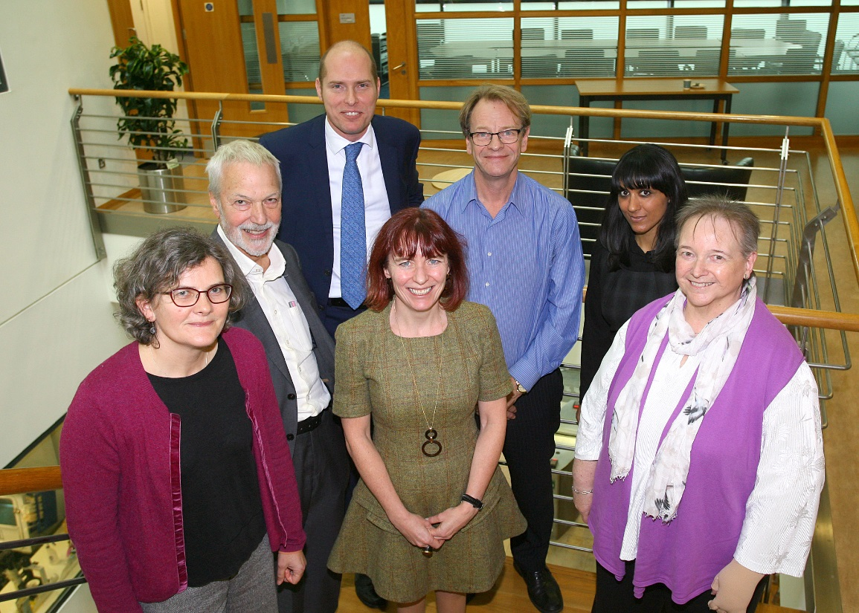
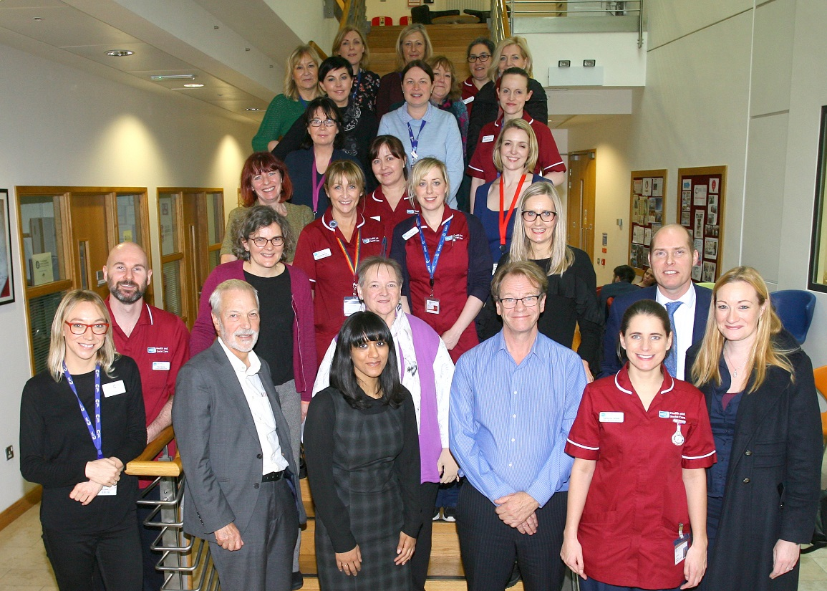
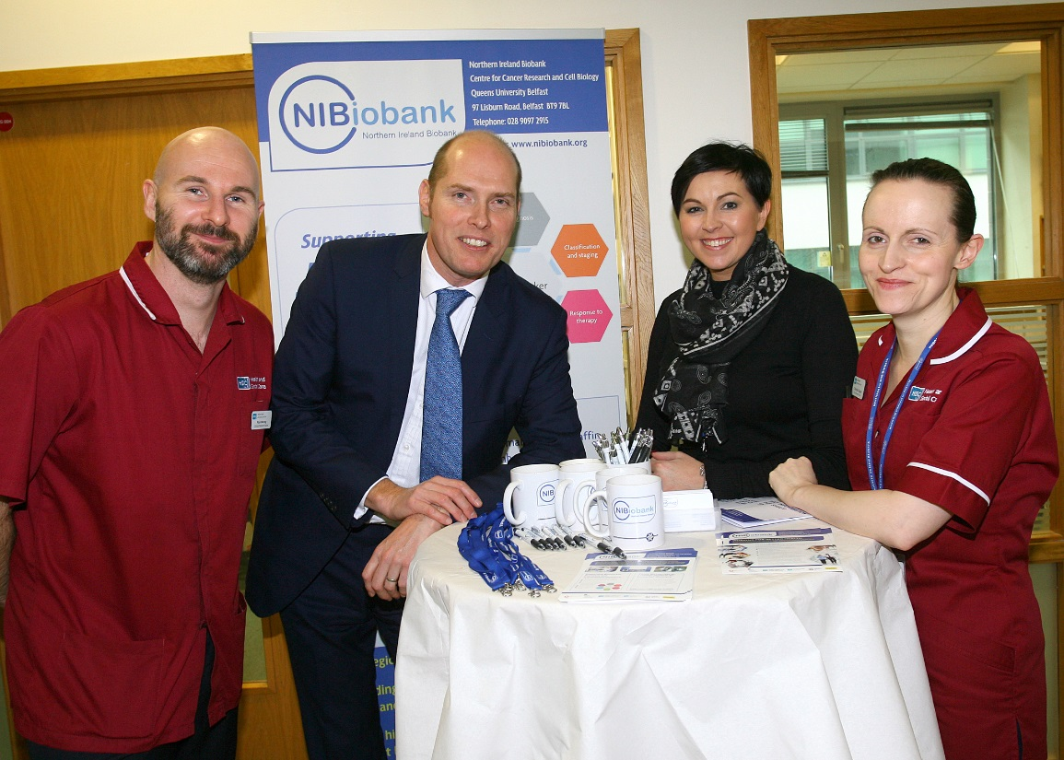
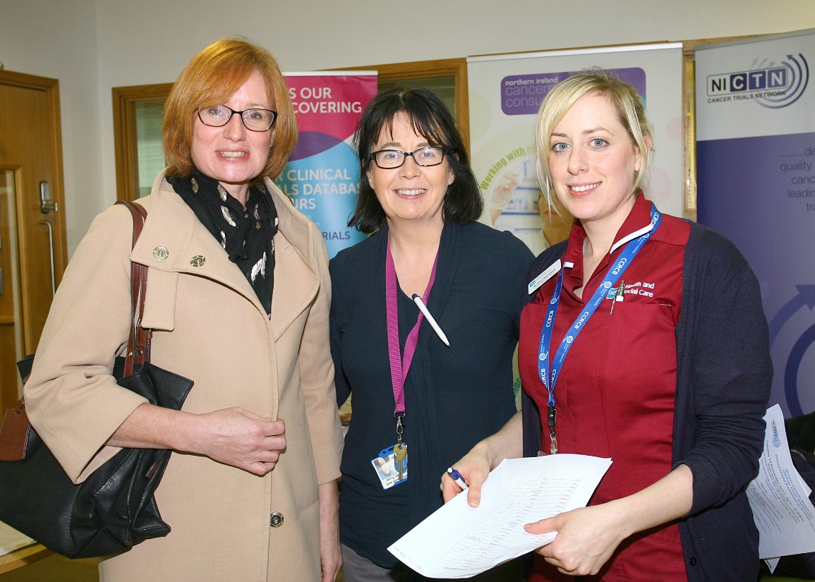
Showcase Speakers
Speakers with some of the attendees
Information Stands by
CRUK, NICRCF and NICTN
NI Biobank Information Stand

